Slide 1
Advanced
ArcMap Editing

Slide 2
Productive Editing Techniques
Typical challenges when editing features
  Controlling Feature Snapping
  Editing/Sketching Efficiently
  Assuring Coincidence and Accuracy
  Managing Feature Selection
  Bulk Editing

Slide 3
Snapping
Problem
How do I know what
I am snapping to?

Slide 4
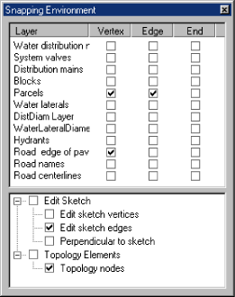
Snap Priority
Open Snap options in the Editor dropdown
Checked layers on top have a higher priority to be snapped to
Drag layers up or down based on your need

Slide 5
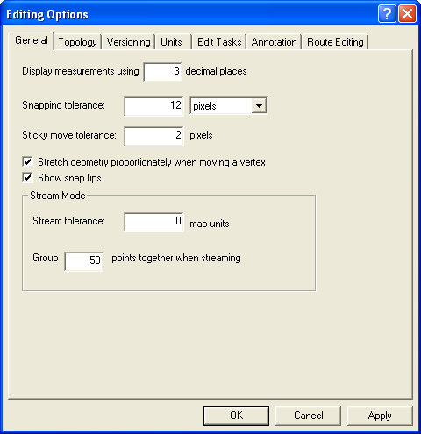
Snap Tolerance
On Editor Toolbar Edit>Options
Set snap tolerance to ensure snapping at your editing scale
When editing press the T key to see your snapping range
Pixel vs. map units
  Depends on need & user

Slide 6
Snap Tolerance Tool
Set the tolerance as you edit or based on the features you are editing
Tool located in the editor group

Slide 7
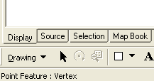

Snap Tips and Indicator
Snap Tips
  Check snap tips in Editor options
  Hover over a valid feature to snap to and a box will appear
Snap Indicator
  Bottom Right of ArcMap

Slide 8
Snap Overriding
Quick
  Override snaps at any time by holding onto the spacebar while editing
Time Consuming
  Uncheck all features in the snapping dialog

Slide 9
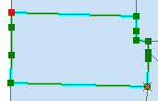
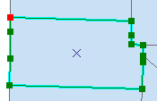
Selection Anchor
On all features there is a selection anchor when you select one or more features
Always by default in the center of the feature or features
Move selection by holding the Ctrl key and hovering over anchor
Allows you to snap edge and ends to other edge and ends

Slide 10
Secondary Selection Anchor
Selecting the line feature
Pressing the S key to create an Auxiliary Selection Anchor
Position both anchors
Clicking on the Rotate tool in the Editor toolbar to position the selection anchors
The first anchor acts as the pivot point and the second anchor acts as the snapping point so the features can rotate and snapping will occur

Slide 11
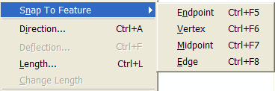
Snapping to a Specific Feature
Click the tool palette dropdown arrow and click the Sketch tool
Right-click the feature to which you want to snap your next vertex
On the dropdown menu, choose Snap to Feature
Click the part of the feature to which you want to snap the next vertex. The vertex will be placed at the nearest location that matches your selection.

Slide 12
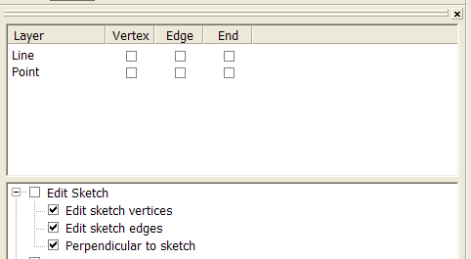
Snap to Sketch
Edit Sketch Vertices
  Allows snapping to newly added vertices
Edit Sketch Edges
  Lets you snap to the edge of new sketch
Perpendicular to Sketch
  Angular constraints are applied to 90° from last sketch

Slide 13
Sticky Tolerance
Allows you to set a minimum number of pixels your pointer must move on the screen before a selected feature is moved
Useful way to prevent features from being accidentally moved small distances when they are clicked with the Edit tool
Set on the General tab of the Editing Options dialog box

Slide 14
Editing
Remember “3 T’s of editing”:
On Editing toolbar check
Target Layer
Edit Task
Edit Tool

Slide 15
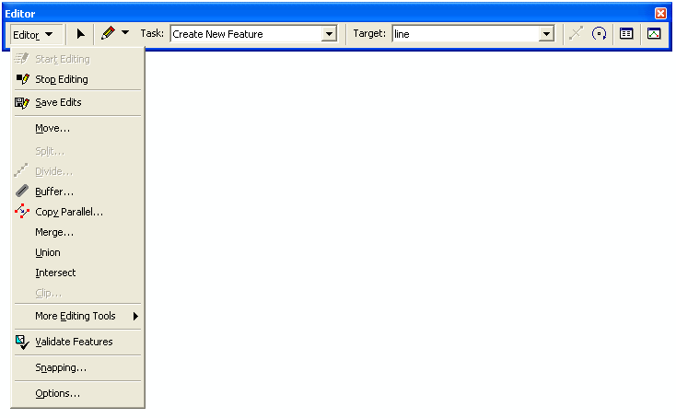

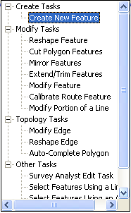
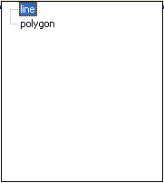
Edit Tools
The Editor Toolbar
Edit tool: lets you select and modify features
Tool palette: use these tools to create a sketch
Current Task dropdown list: these tasks work with a sketch drawn using the sketch construction tools on the palette
Target layer dropdown list: Sets the layer to which new features will belong
Split tool: lets you split a line segment at a specific location
Attributes button: Opens the attributes dialog box, show/edit attributes for selected feature
Edit session commands
Rotate tool: rotate a segment or sketch to a desired orientation
Sketch properties: Lets you specify the x, y (and m or z) locations of the vertices in a sketch

Slide 16
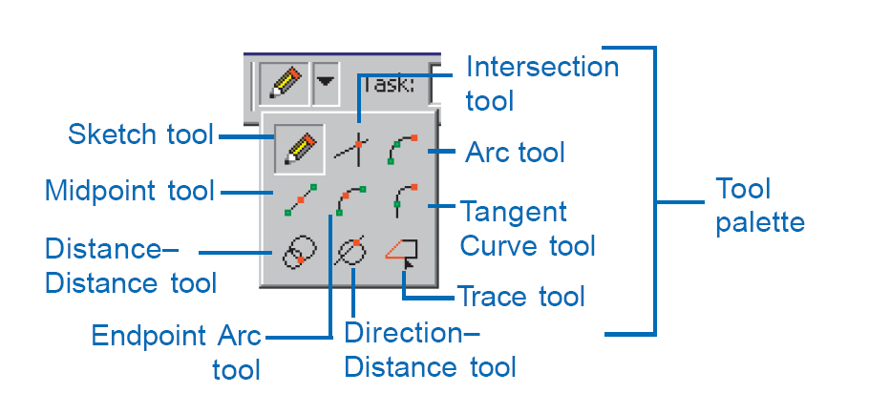
The Sketch Tool
Many different options depending on what you want to do. The pencil is the most common.

Slide 17
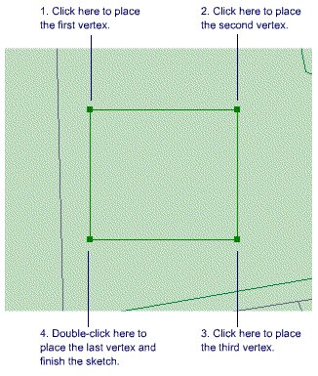
Sketch Tool
Use the Sketch tool to create point features and digitize the vertices of line or polygon features. After you finish the sketch, ArcMap adds the final segment and the sketch turns into a feature.

Slide 18
Sketch Tool Shortcuts
Ctrl + A Angle
Ctrl + F Deflection
Ctrl + L Length
Ctrl + D Delta x,y
Ctrl + G Direction/Length
Ctrl + P Parallel
Ctrl + E Perpendicular
Ctrl + T Tangent Curve
T key Display the snapping tolerance
F6 Absolute x,y
F7 Segment Deflection
F8 Streaming
Ctrl + Delete Delete sketch
F2 Finish sketch

Slide 19
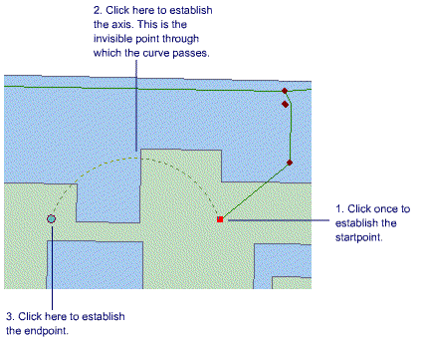
Arc tool
The Arc tool helps you create a segment that is a parametric (true) curve. Instead of being made of numerous vertices, a parametric curve has only two vertices as endpoints.

Slide 20
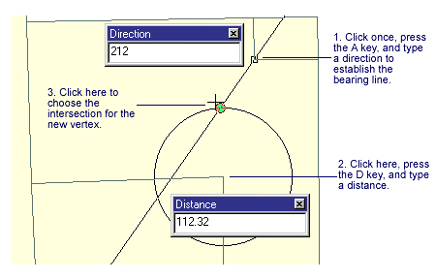
Direction-Distance tool
The Direction–Distance tool allows you to create a vertex using a distance from a known point plus a direction from a known point to define a bearing line.

Slide 21
Direction-Distance Tool Shortcuts
Shortcut Key Editing Function
D or A key Direction
D or R key Distance
Tab Change location

Slide 22
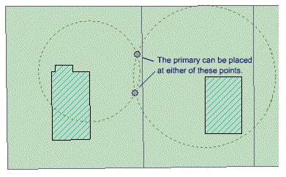
Distance-Distance Tool
This tool lets you create a point or vertex at the intersection of two distances from two other points.

Slide 23
Distance-Distance Tool
Shortcut Key Editing Function
D or R key Distance
Tab Change location

Slide 24
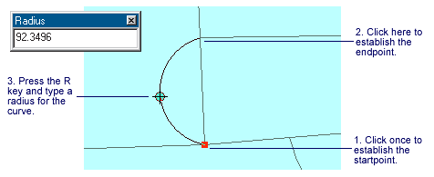
Endpoint Arc Tool
The Endpoint Arc tool allows you to specify the start and endpoints of the curve, then define a radius for the curve.
Shortcut Key Editing Function
R key Radius for Endpoint Arc tool

Slide 25
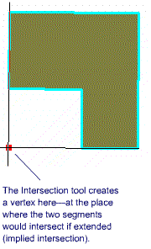
Intersection Tool
The Intersection tool creates a point or vertex at the place where two segments would intersect if extended far enough.

Slide 26
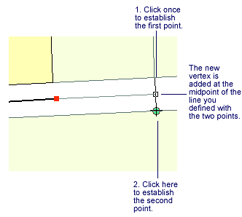
Midpoint Tool
The Midpoint tool lets you define the location of the next vertex by clicking two points; the new vertex is placed at the midpoint of the line between these points.

Slide 27
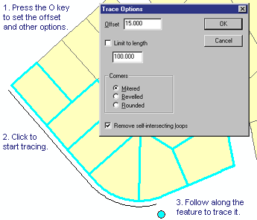
Trace Tool
The Trace Tool helps you create segments that follow along existing segments. The Trace Tool only follows selected features.
Press o-key for trace options and offset
Distances are in + for right of the digitized direction and – for left
Tab key also traces the other side

Slide 28
Scale and Rotate Tools
Allows features to be scaled and rotated based on a point
Shortcut Key Editing Function
A key Set rotate angle
S key Toggle secondary anchor

Slide 29
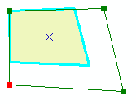
Stretching a Feature Proportionally
Click the Edit tool and click the feature you want to stretch.
Click the Editor menu and click Options> General tab.
Check the box to stretch the feature proportionately.
Position the pointer over the vertex you want to move until the pointer changes.
Drag the vertex to the desired location.
Right-click any part of the sketch and click Finish Sketch.
The feature is stretched proportionately

Slide 30
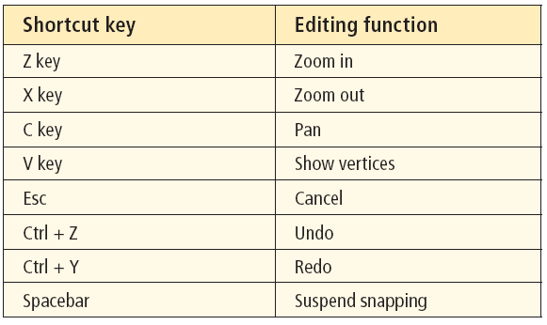
Switch Between Tools
Use the E Key to switch between sketch and edit

Slide 31
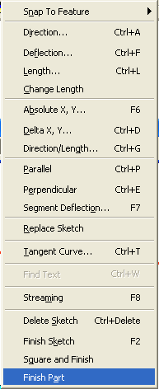





Edit Sketch Context Tools
Right click with a sketch tool while editing gives you many additional options or constraints
Sketch tool context menu

Slide 32
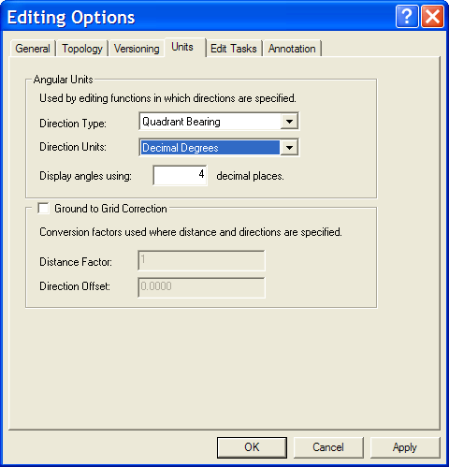
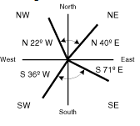
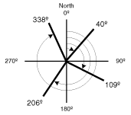

Editing Options
Editor>Editing options will give you options in how you enter values
  Direction
  Units
Sample Quadrant
Sample Azimuth

Slide 33
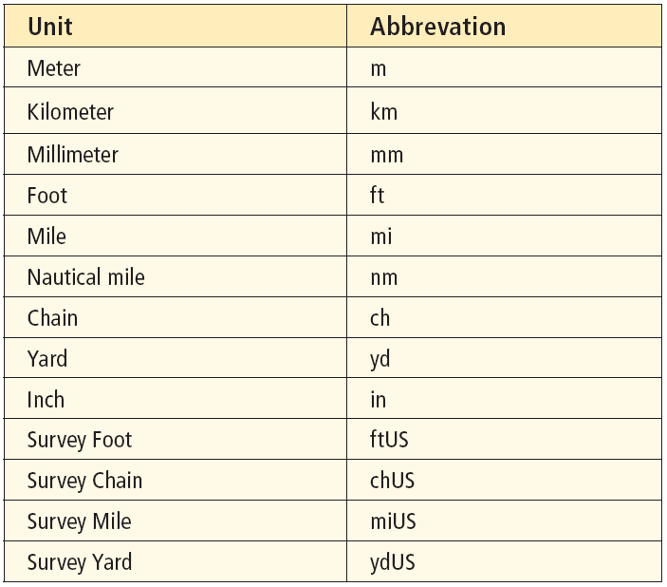

Sketch Units Conversions
Ensure units are defined
When entering the length tell the units you want the measurement in

Slide 34
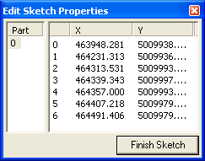
Sketch Properties
When modifying a feature you can
  Remove vertices
    Right click and remove
    Select many and Remove
  Add vertices exactly between two
    Right click on vertex no and choose add before
  Remove multi-parts
    Right click on part and choose to remove
  Modify coordinates
    Edit coordinate explicitly

Slide 35

Working with Multipart Features
Think of Hawaii as a multipart feature
Removing
  Explode with on advanced editing toolbar
  Delete parts in sketch properties
Creating
  Merge two non connected features
  When drawing finish part to start next feature part
Cannot be used with network features

Slide 36
Copying and Pasting Features
Use standard copy/paste for like geometry or lower geometry feature type
Ensure target layer is correct
Like attributes will copy as well

Slide 37
Copying and Pasting Attributes
Select the feature in the attributes window you want to copy
Right click and choose copy
Choose the feature you want to copy to and right click and choose paste

Slide 38
Edit Tasks
Create Tasks
Modify Tasks
  Reshaping – modify portion of the line
  Cut Polygon – split a polygon into two features
  Mirror features – Create a mirror image of a feature
  Extend/Trim – fix under and overshoots
  Modify – reshape a feature
Topology
  Auto Complete polygon – Use existing polygons to finish sketch against

Slide 39



Reshape Feature Task
The Reshape Feature task lets you reshape a line or polygon by constructing a sketch over the feature.

Slide 40
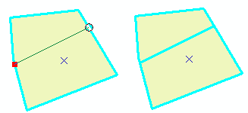
Cut Polygon Task
Splits a polygon into two features by sketching across it
Must start and finish sketch outside the polygon or snapped to its edge

Slide 41
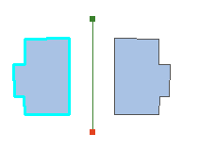
Mirror Features Task
The Mirror task creates a mirror image of selected features on the other side of a line you create
Select your feature then draw a mirroring line.

Slide 42
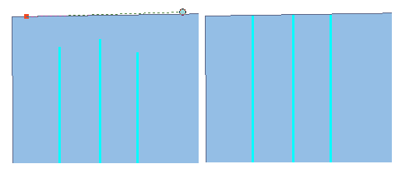
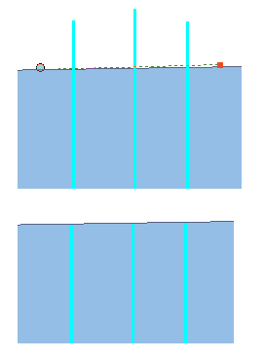
Extend/Trim Features Task
The Trim/Extend command reduces/extends the length of a line sketch you specify from the last vertex.

Slide 43
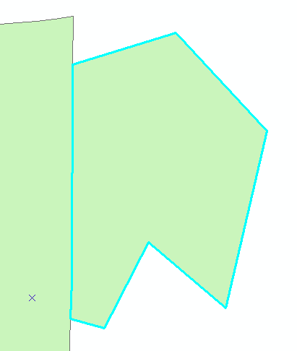
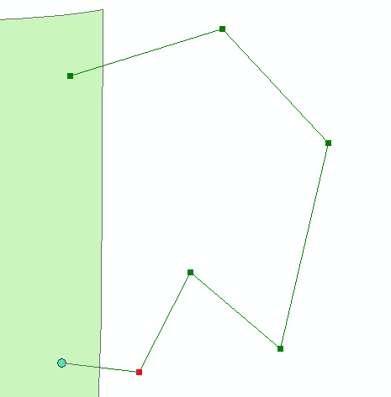
Auto Complete Polygon Task
Starting from the boundary of an existing polygon, use the Sketch tool to digitize a boundary of the new polygon that will share a boundary with the existing polygon.
To finish the sketch just snap inside the existing polygon.

Slide 44
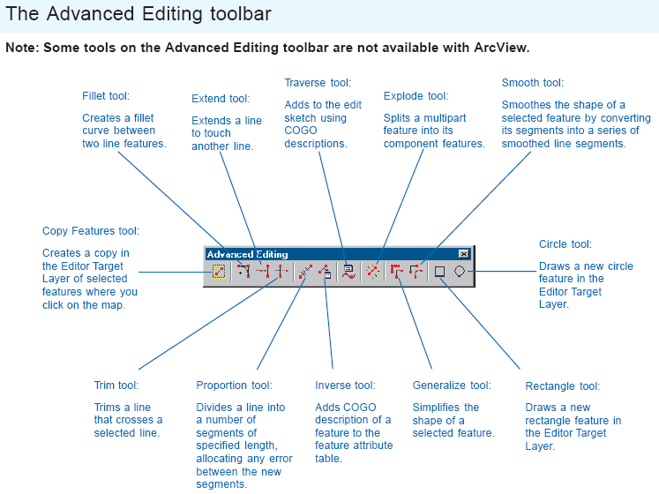
Advanced Editing Toolbar

Slide 45
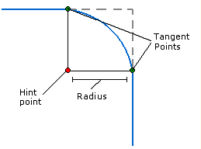
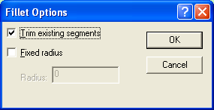
Fillet Tool
Creates a circular to two line segments from the original feature
The curve is constructed using a radius through tangent points to define the curve

Slide 46
Extend/Trim Tool
Extends lines until they touch selected lines
Select feature you want lines to extend to
Then click lines you want to extend
Trims the intersecting portions of lines
Select feature you want lines to be trimmed by
Then click the line segments you want to trim

Slide 47

Proportion Tool
Splits line into desired segments
Type the lengths of the segments into which the line will be divided.
Optionally, click Reverse to switch the orientation of the line if the arrows indicating the orientation of the feature on the map are the reverse of the order in which you entered the segments.
The line is split proportionally to the length of the measured segments. Any difference between the line length and the sum of the length of the segments is allocated proportionately to the new lines' length.

Slide 48
Inverse Tool
Generates a COGO description of a line.
The feature must be either a straight line or circular arc. It typically only has two vertices, but more are allowed as long as the feature is consistently straight or consistently curved. The current direction type and angular units are used when populating the attributes.
All COGO line feature classes must have the following attributes as text fields: Direction, Distance, Radius, Delta, Tangent, Arc length, and Side. You can use the Create COGO Fields tool in ArcCatalog to add these fields to your feature class table.

Slide 49
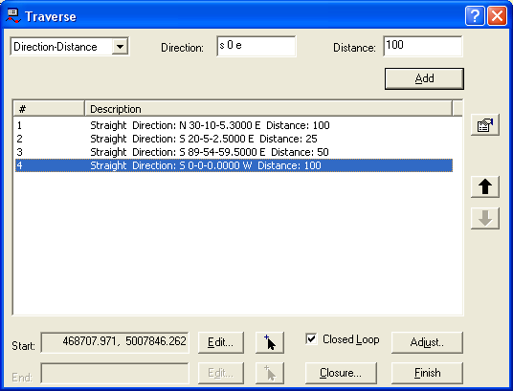
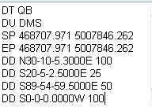
Transverse Tool
Allows you to enter and edit precise distances and angles
Allows you to save and load single transverses
Format example for loading a transverse

Slide 50
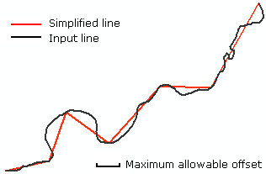
Generalize Tool
The Generalize Tool simplifies the shape of the selected features the degree to which the geometry is simplified depends on the maximum allowable offset, which limits how far the output geometry can be from the input geometry.

Slide 51
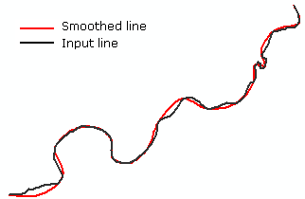
Smooth Tool
The Smooth Tool is used to smooth the straight edges and angular corners of a feature. The feature geometry is replaced by a series of smoothed line segments.

Slide 52
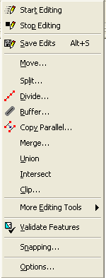
Editor Tools
Under the Editor Tool Dropdown
Creates features on target layer
Does not update attributes

Slide 53

Move Tool
Move features a desired distance in map units

Slide 54
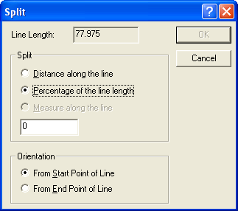
Split Tool
Splits a line into two pieces based on distance or percentage

Slide 55
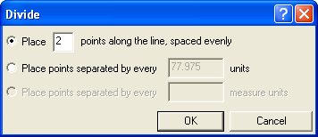
Divide Tool
The Divide Tool allows you to divide a selected line into a number of segments
Select a line feature to split it into segments
Select a point feature to create points along the line

Slide 56

Buffer
Buffers selected features a desired distance and creates features on the target layer

Slide 57
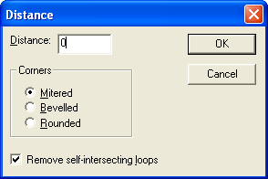
Copy Parallel
Copies a feature parallel to your selected features
Negative values copy to the right of digitized direction
Positive values copy to the left of digitized direction

Slide 58
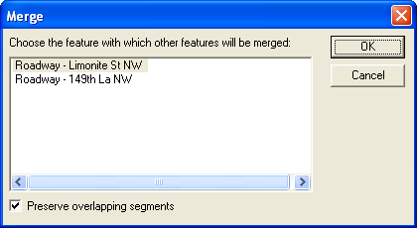
Merge
Merges two features together
Caution: May create multi-part features
Cannot be used in Geometric Network Features
Uncheck preserve overlapping segments to help eliminate multipart segments

Slide 59
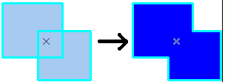
Union
Union works like merge except it creates a new feature and retains the old features
You can Union features based on different layers
You can use Union in a geometric network where you can not use Merge

Slide 60
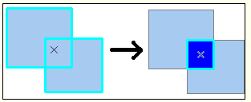
Intersect
Creates a new feature from the common parts of two selected features of the same geometry type

Slide 61
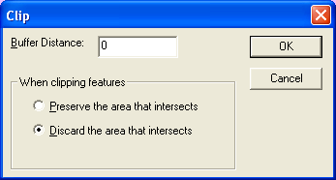
Clip
Only polygon features can be clipped
Can use any selected feature as the bases of a clip
Preserve will keep the areas that are inside the buffer and remove all other touching features
Discard will only remove the area within the buffer distance

Slide 62

Topology Toolbar
Start Editing
On the topology toolbar, click the Map Topology button
Check the features that will participate in the topology. Also set the cluster tolerance.
  The cluster tolerance is the minimum distance vertices can be next to each other.
  If vertices fall within this distance, they will be snapped together.
Click the Topology Edit tool and click the features you want to edit using the map topology. The map topology is created for the features that are visible in the current display extent.

Slide 63
Topology Edit Tool
Shortcut key Editing function
Shift Add to/Remove from the selection
Ctrl Move the selection anchor
N key Select nodes
E key Select edges
S key Split and move node

Slide 64
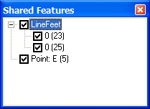
Shared Features
Choose which Features you want to participate

Slide 65
Selecting Features
Ways to select features
  Use the selection tools
  Use the editing tools
  Select by attributes
  Select by location

Slide 66
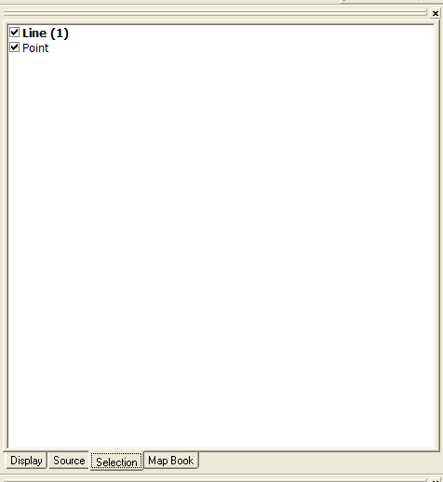

Selection Tab
Use selection tab for setting and unselecting features
Bold layers have features selected and count
Right click for other selection options

Slide 67



Hidden Selection Tools
Buried selection tools found in the customize options
Add to a Toolbar or Context Menu

Slide 68

Select by Attributes
Create SQL to create-add-remove or select from based on desired criteria
Ability to save and re-run

Slide 69

Unselect Individual Features
Hold Shift & click on feature
Right click on attribute window and select unselect

Slide 70
Layer Selection Options
Options available for feature layer by right clicking
Create layer of selected features for display
Make this the only selectable layer

Slide 71

Selecting the “Next” Feature
If multiple features are stacked on top of one another pressing the n key will cycle through the features

Slide 72

Select By Location
Selected features based on spatial proximity
Can be used in conjunction with other selection operations for result

Slide 73
Bulk Editing
Ways to update multiple features quickly and accurately

Slide 74

Bulk Editing Using the Attributes Window
Clicking on the top most heading then entering in the value will update all attributes of that feature

Slide 75

Field Calculator For Updating Multiple Records
Updates all features if none are selected
Updates only the selected features if features are selected
Right click on the attribute table and choose calculate values

Slide 76

Field Calculator
Enter in values, expressions or functions
Fields are enclosed in square brackets [ ]
Text strings are enclosed in double quotes: "text"
Use & to join functions
Use () to give priority to functions
Check advanced for VBA functions

Slide 77
Field Calculator
Utilizing Joins
When joining features based on a one-to-one or many-to-one join you can pass values from the join table to the feature table by calculating features
You cannot calculate based on relationships or create joins on one-to- many or many-to-many cardinality

Slide 78
Common Field Calculations
[Field1] & [Field2] = Field1Field2
[Field1] &” “& [Field2] = Field1 Field2
[Field1] &”TEXT“& [Field2] = Field1TEXTField2
[Number] * .5 = Resultant Answer

Slide 79
Other Calculations
Easy Calculate
  Download at http://www.ian-ko.com/
  A bunch of useful saved calculations that can be used
Proper Text
  strconv( [Field] ,vbPropercase)
Last name isolate from full name
  Left( [field] , (InStr(1, [field] , " ")-1))

Slide 80

Field Calculator For
Populating New Data
Using functions and nesting functions to create new data
Below will pull the house number out of the address string

Slide 81

Complex VB Calculations
To add the x coordinate of points:
    Dim Output As Double
    Dim pPoint As IPoint
    Set pPoint = [Shape]
    Output = pPoint.X

Slide 82


Field Calculator Utilizing Geoprocessing
Use ArcTool box to calculate values
Allows you to build many calculates within a model

Slide 83

Field Calculator
Utilizing Models
Can use Model Builder to create complex calculations without knowing programming
Allows you to rerun the calculations many times using parameters

Slide 84
Creating a Model
Backup data incase of incorrect model creation
Open ArcTool box and Right Click to create a new toolbox
Next right click on new toolbox to create a Model
Drag geoprocessing tools that meet your needs into your model
Connect them logically with the connect tool

Slide 85
Creating a Model
Set up desired parameters in the tools
Add data to satisfy the model for each tool
Save the model
Run the model

Slide 86
Help Tips
Find ArcGIS Desktop Help Online
Application Help http://webhelp.esri.com/
ArcScripts http://arcscripts.esri.com
ESRI Support Center: http://support.esri.com
    Forums
    Knowledge Base
    Technical Articles
EDN – ESRI Developer Network: http://edn.esri.com

